Slide 2
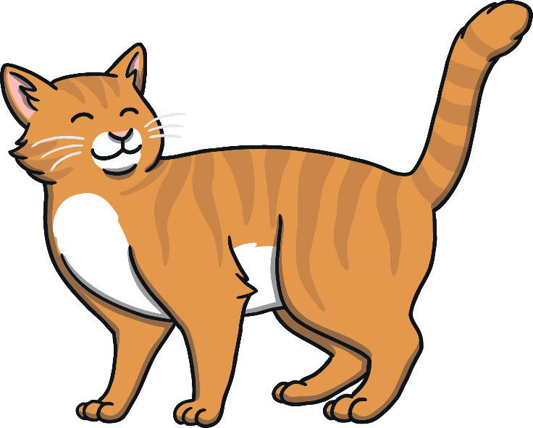
c
a
t

Slide 3
d
o
g

Slide 4
h
a
t

Slide 5
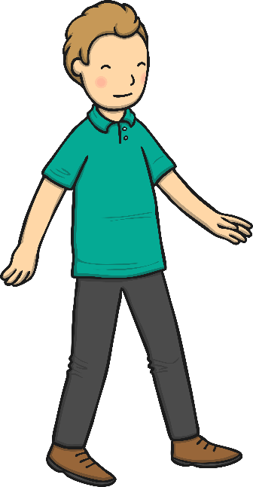
m
a
n

Slide 6
p
i
n

Slide 7
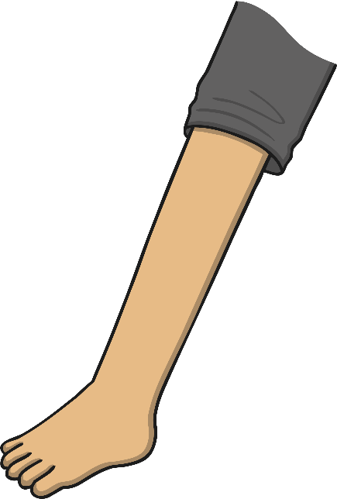
l
e
g

Slide 8
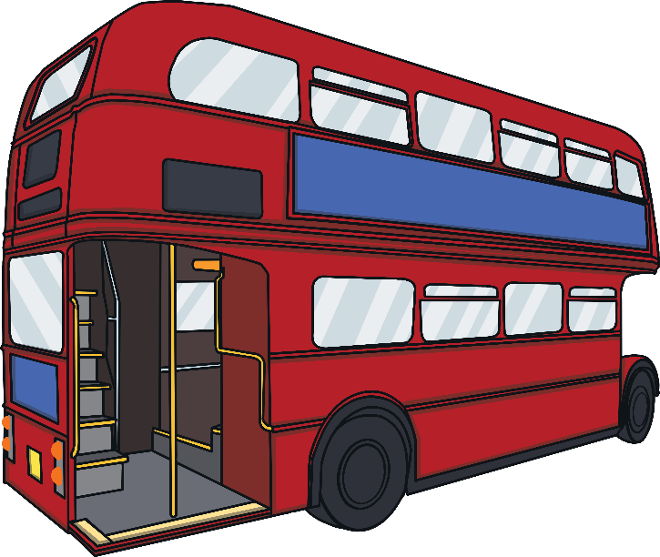
b
u
s

Slide 9
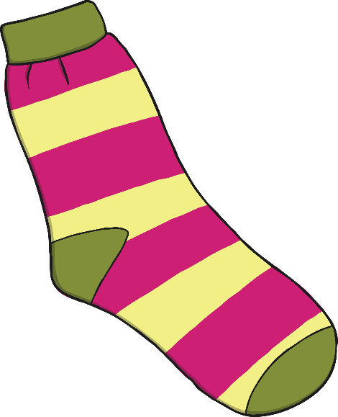
s
o
ck

Slide 10
b
e
ll

Slide 11
t
a
p

Slide 12
s
u
n

Slide 13
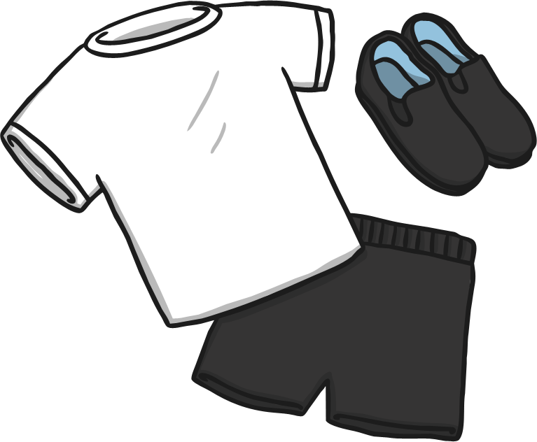
k
i
t

Slide 14
s
a
d

Slide 15
r
a
g

Slide 16
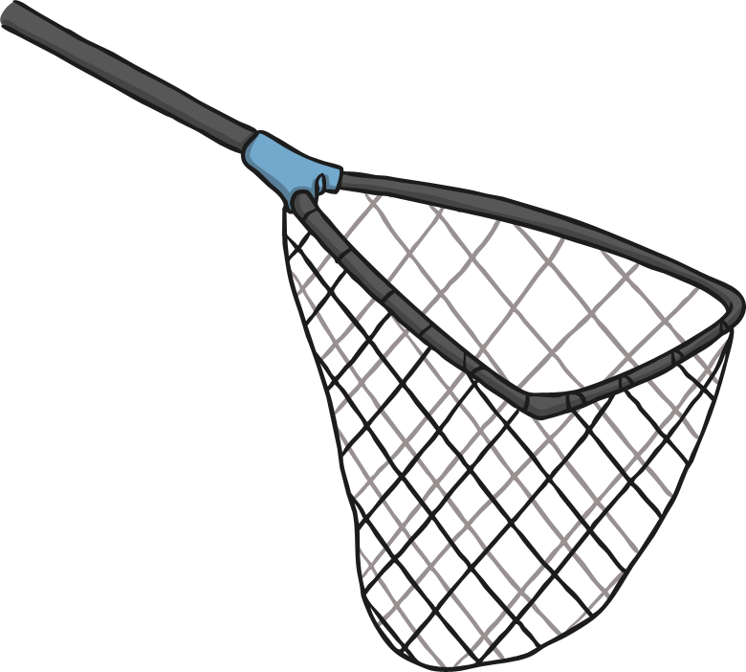
n
e
t

Slide 17
h
i
ss

Slide 18
m
u
g

Slide 19
p
u
ff

Slide 20
f
i
n

Slide 21
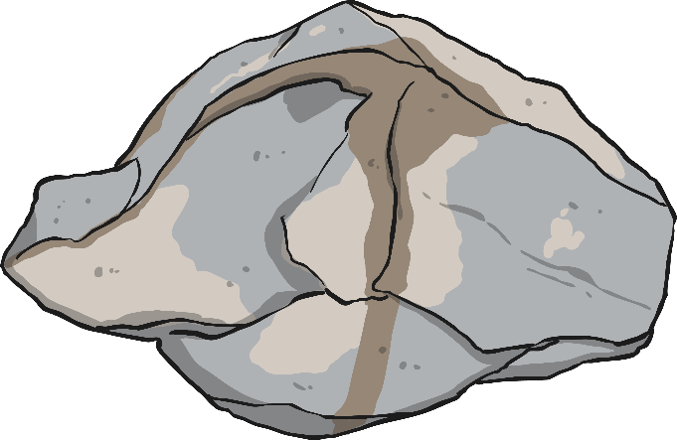
r
o
ck

